Slide 1


Integrating NEON and USDA-ARS Water Quality Data for Southeast Rivers ICRW8 Corvallis, Oregon – June 5-8, 2023
Kaelin Cawley, Aquatic Biogeochemist, NEON, Battelle
Jim Coloso, Data Scientist, NEON, Battelle
Bobby Hensley, Aquatic Biogeochemist, NEON, Battelle
Oliva Pisani, Research Chemist, Southeast Watershed Research Lab, Tifton, GA, USDA-ARS

Slide 2
What is the National Ecological Observatory Network (NEON)?
The National Science Foundation’s NEON program is a continental-scale ecological observation facility operated by Battelle. NEON provides:
Free and open data on the drivers of and responses to ecological change
A standardized and reliable framework for research and experiments
Data interoperability for integration with other national and international network science programs
Including National Rivers and Streams Assessment (EPA), USGS, USDA, LTER, etc.
Notes:
What do you know about NEON?
Does anyone live near a NEON site?

Slide 3
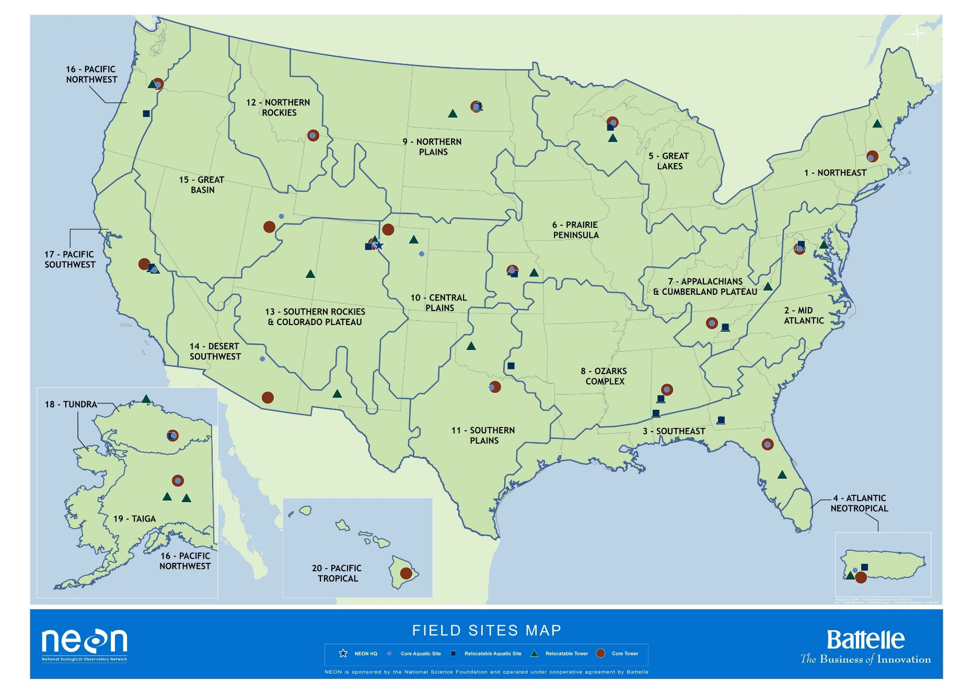

NEON’s field sites and data products
81
FIELD SITES
47 terrestrial
34 aquatic
181
DATA PRODUCTS
62
ORGANISMAL SAMPLE TYPES
Notes:
Continental scale: Integrated data collection at 81 field sites distributed across 20 domains – or ecoregions – in the United States (including Puerto Rico, Alaska, and Hawaii). Samples are collected from all 81 sites and sent to biorepository for use by the external research community.
34 aquatic sites – 24 streams, 7 lakes, 3 rivers,
Of the 181 data products, 50 are organismal
62 organismal sample types are archived at the biorepository
Standardization of methods for data collection: The importance of establishing this sound foundation goes to the core of what makes NEON special – as the observatory is designed to collect comparable data utilizing consistent methods across a huge diversity of ecosystems.

Slide 4
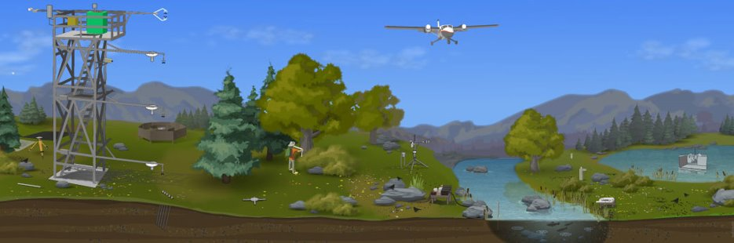
How does NEON collect data and samples?
Airborne observation platform
Automated instrument systems
Observational sampling
Notes:
Aquatic and Terrestrial
Standardized, collated methods across sites

Slide 5




NEON Flint River Site (FLNT)

Slide 6
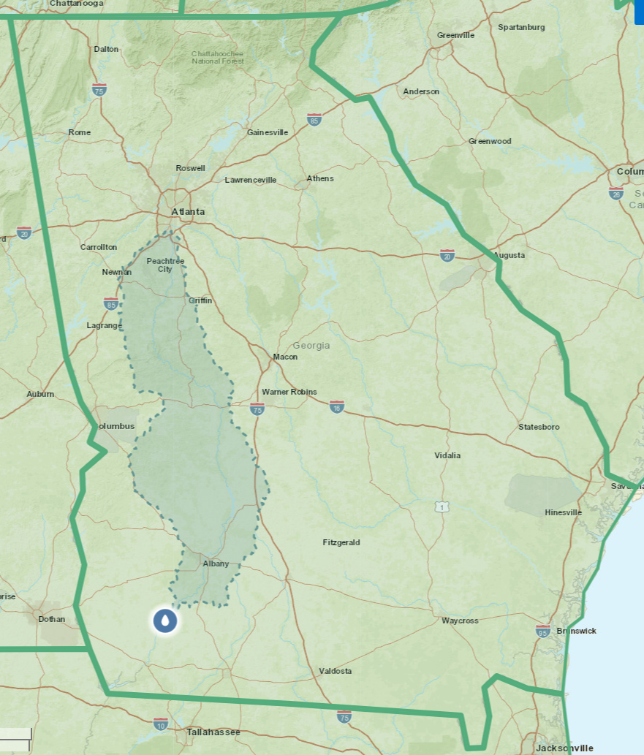
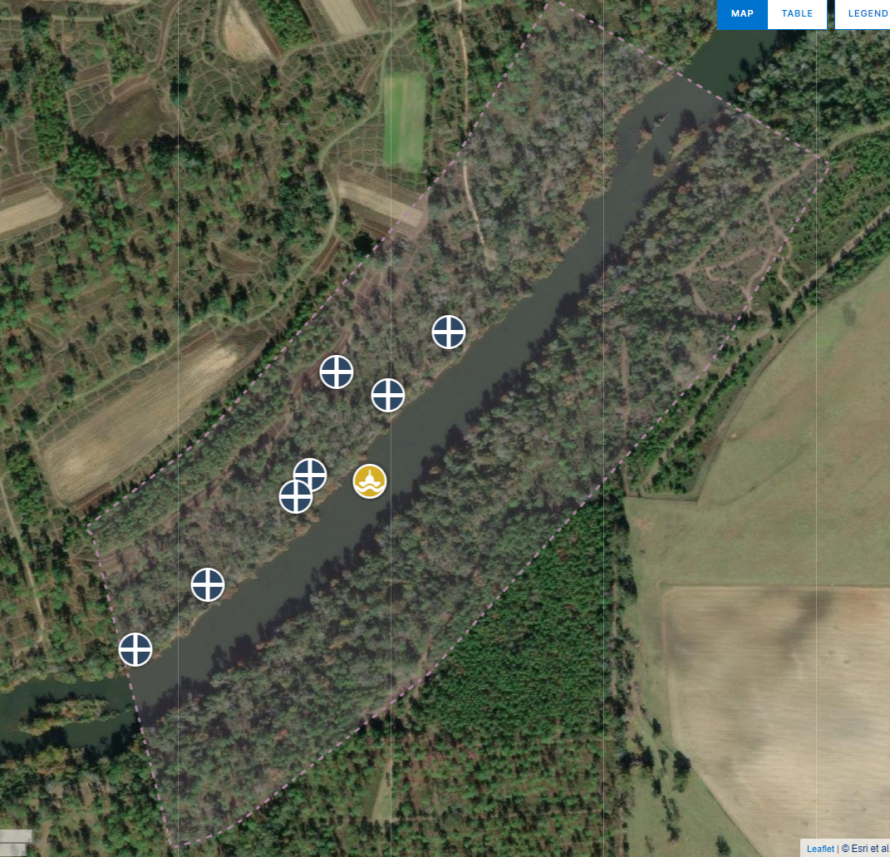
NEON Flint River Site (FLNT)
Notes:
Watershed: 15,000 km²
1 km long
Jones ERC

Slide 7
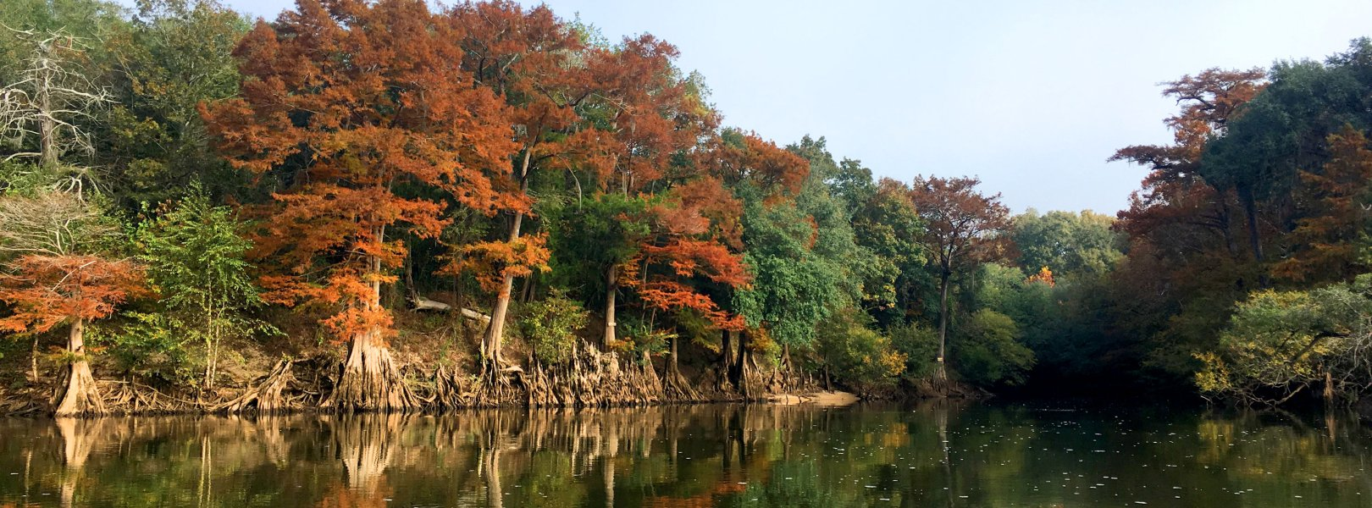
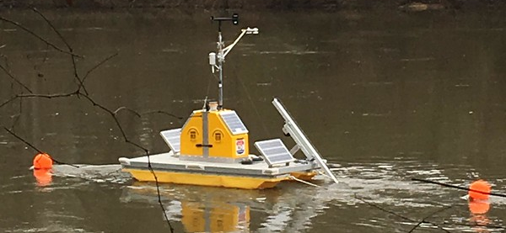
NEON Flint River Site (FLNT)
Full suite of NEON aquatic observational sampling (except fish) – 23 data products
Instrumented buoy – 17 data products
Riparian Met station – 6 data products
Site co-located with the NEON JERC terrestrial site
Notes:
water chemistry, discharge, dissolved gas, groundwater chem, macroinverts, periphyton, sediment chem….
water elevation, continuous discharge, nitrate, water quality (DO, pH, turb, fDOM)…
air temp, wind, BP, net rad, PAR, RH

Slide 8
Little River Experimental Watershed, Tifton, GA
1965 - Southeast Watershed Research Laboratory (SEWRL)
established by Congress.
1966 - Little River watershed was selected to study the
relationships between rainfall, streamflow, and land management.
1967-1971 – Construction of hydrologic monitoring network.
Participant in the CEAP Watersheds Assessments.
1974 – First full year of a water quality monitoring program (Cl, NO₃+NO₂-N, PO₄-P, TSS).
1979 – Analytes added (NH₄-N, TKN, TP).
2002 – Analytes added (DOC, TDN).
2016 – Analytes added (DOM).
Major products: characterization of hydrology, impacts of riparian buffers on water quality, natural resource models (CREAMS, GLEAMS, REMM, advancement of SWAT), impacts of land use changes, remote sensing (crop assessments, soil moisture)
LRB: primary watershed, 334 km²

Slide 9
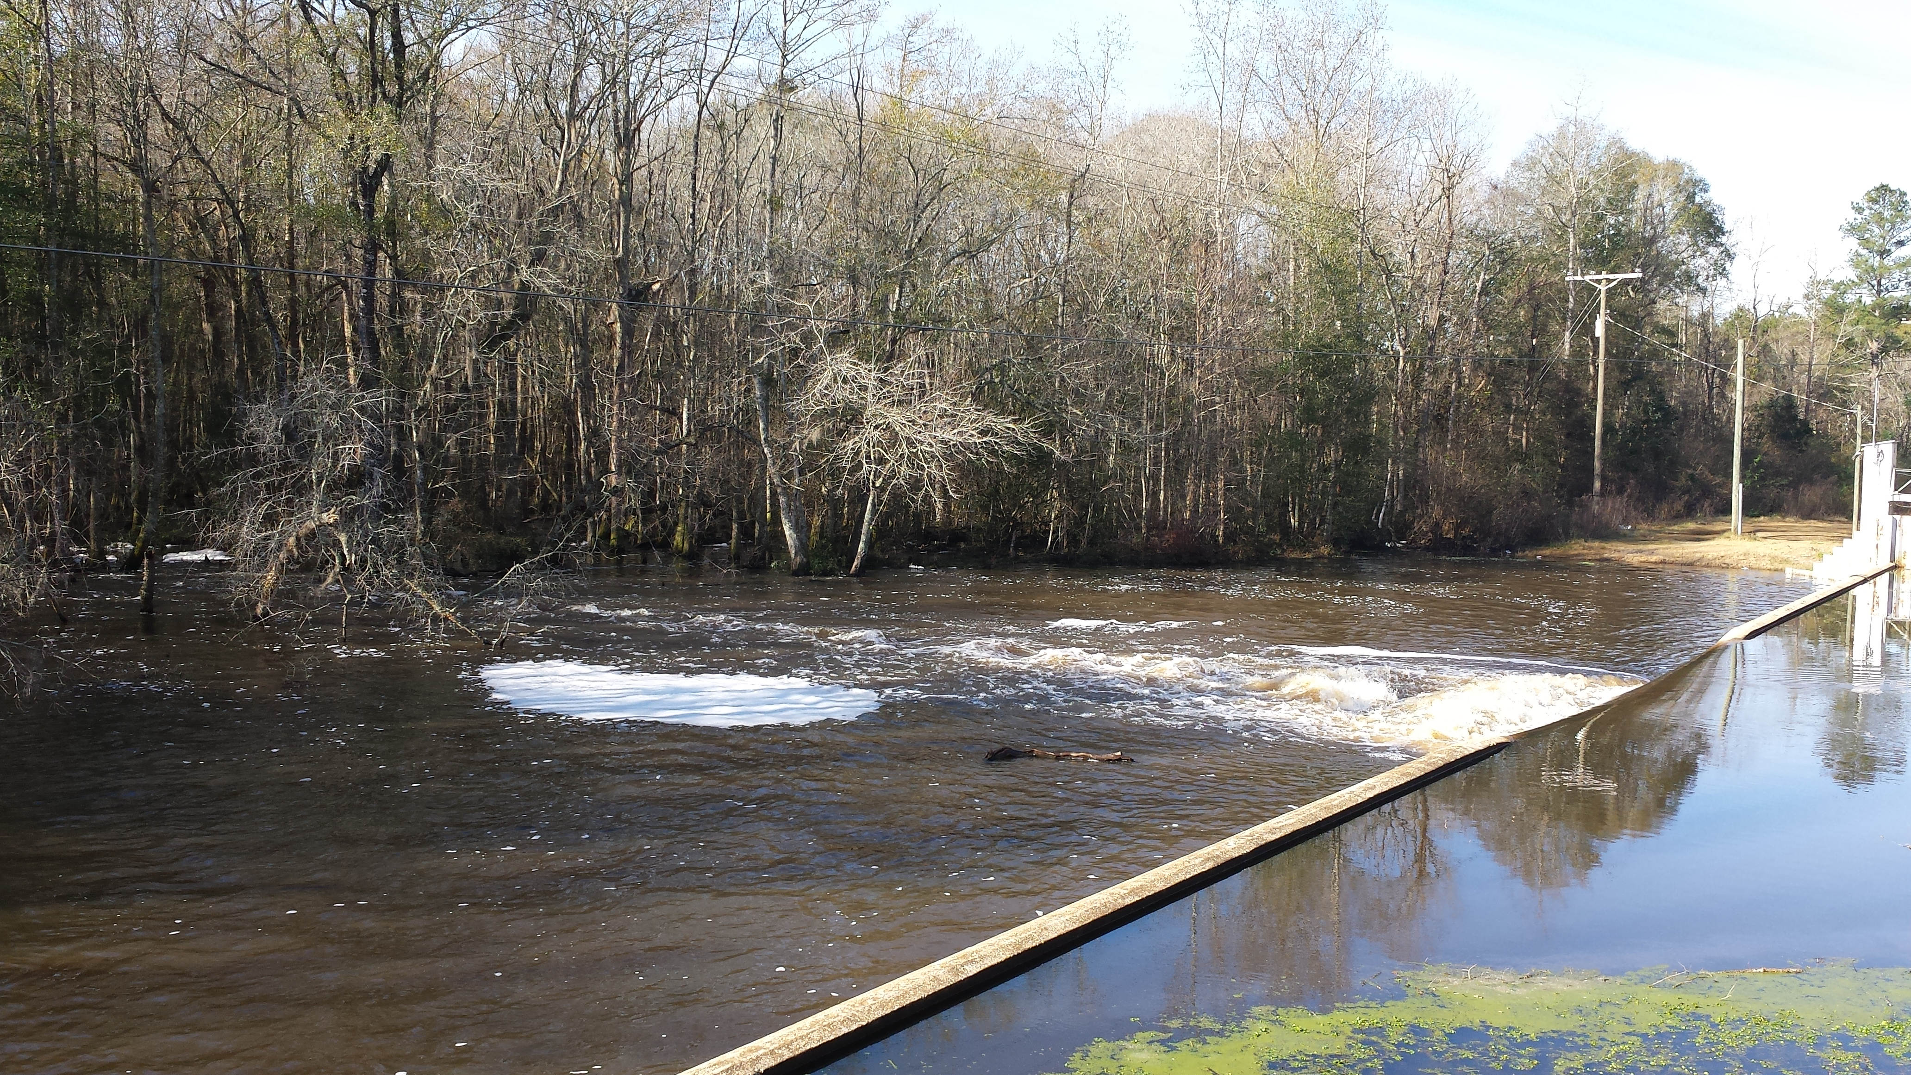
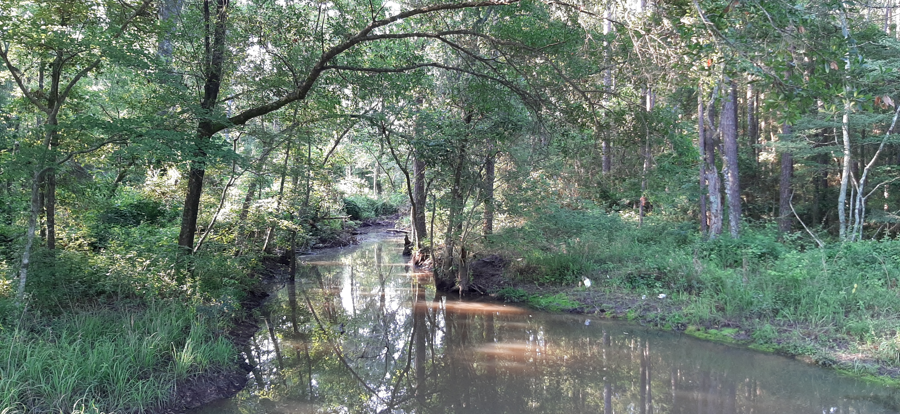
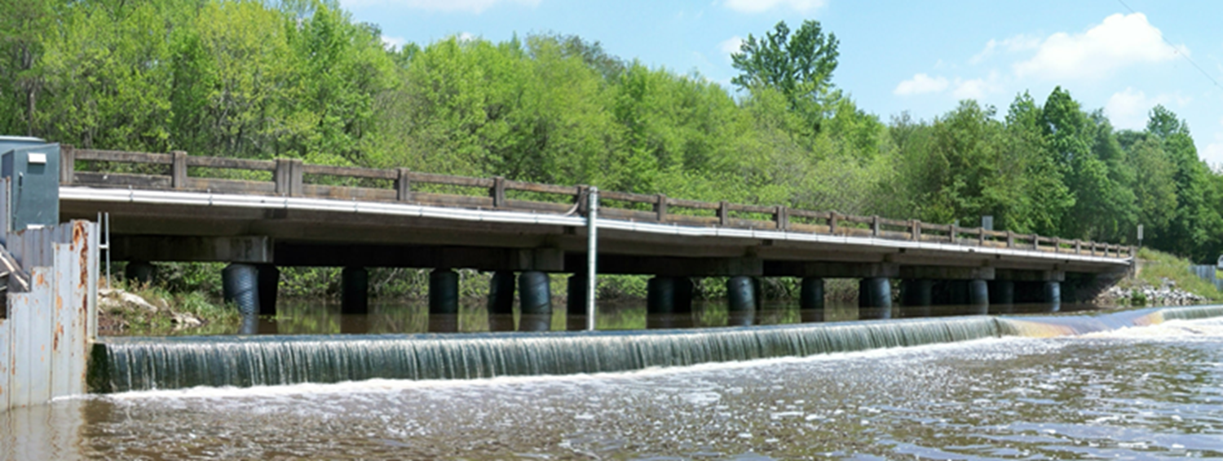
Broad floodplains, river terraces, gently sloping uplands
Sandy surface soils underlain by Hawthorne formation
Hawthorne restricts downward movement of rainfall and leads to lateral water movement to stream channels
Floodplain swamp, floodplain wetland, seasonally flooded wetland, forest wetland, blackwater swamp
Mix of row crop agriculture, pasture, upland and riparian forest
Little River Experimental Watershed relevant publications:
Bosch et al. (2007) Little River Experimental Watershed database. doi:10.1029/2006WR005844
Feyereisen et al. (2008) Long-term stream chemistry trends in the southern Georgia Little River Experimental Watershed. doi:10.2489/jswc.63.6.475
Bosch et al. (2020) Water quality and land cover in the Coastal Plain Little River watershed, Georgia, United States. doi:10.2489/jswc.75.3.263
Pisani et al. (2020) Riparian land cover and hydrology influence stream dissolved organic matter composition in an agricultural watershed. doi:10.1016/j.scitotenv.2020.137165
Bosch et al. (2021) Little River Experimental Watershed, a keystone in understanding of coastal plain watersheds. doi:10.1002/hyp.14334

Slide 10
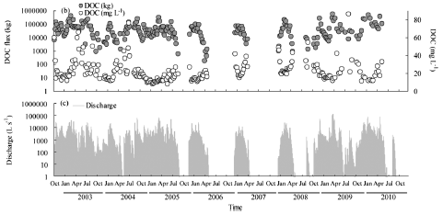
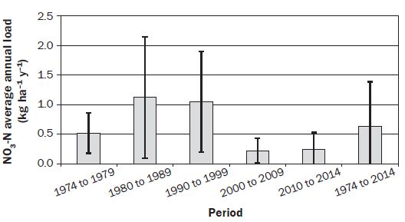
40 years of water quality record
Assess watershed-scale effects of trends in climate, land cover, and land management on water resources
Mehring et al. (2013)
Bosch et al. (2020)
DOC flux (kg)
DOC (mg/L)
Discharge (L/s)
40-year average annual NO₃-N load = 0.64 kg/ha/yr
NO₃-N loading rates are dictated by changes in streamflow volume
NO₃-N loads in the LRB are an order of magnitude less than those reported for similar sized watersheds
Dense riparian buffers
Impacts of drought on DOC
Longer drought periods decrease DOC export but lead to elevated DOC concentrations
Enhanced microbial DOC consumption and CO₂ production
Enhanced local mineralization rates

Slide 11
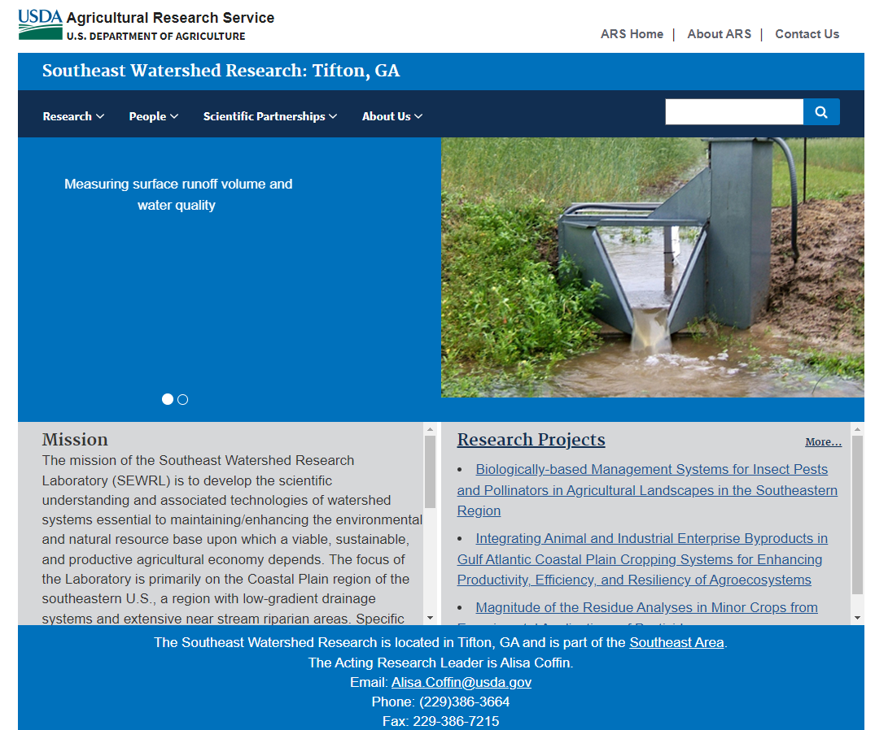
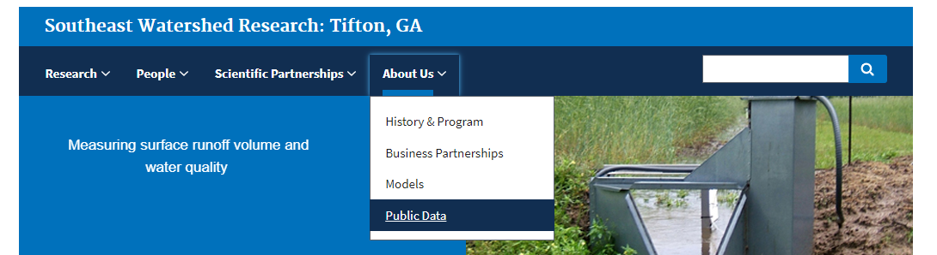
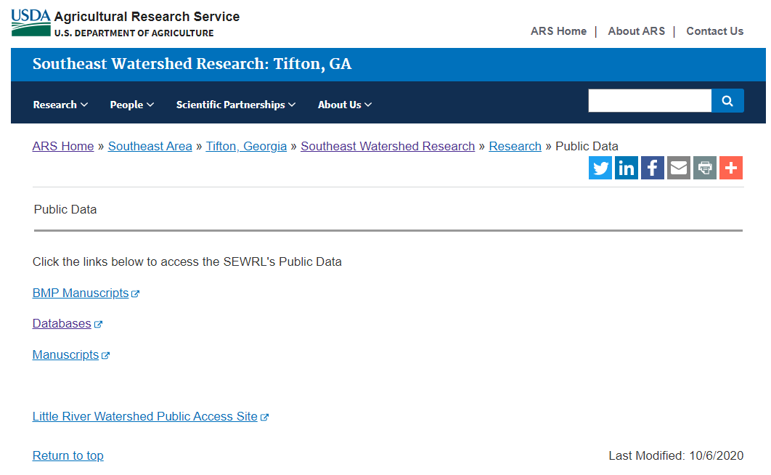
https://www.ars.usda.gov/southeast-area/tifton-ga/southeast-watershed-research/

Slide 12
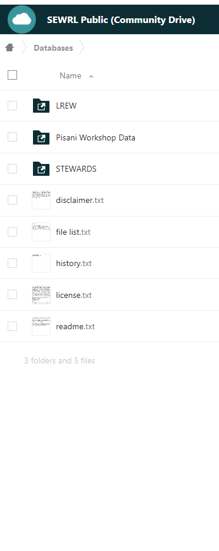
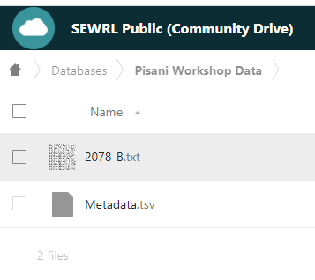
Available metadata: Sample collection & information, filtration, MDLs
When downloading data file, make sure to note the file directory

Slide 13
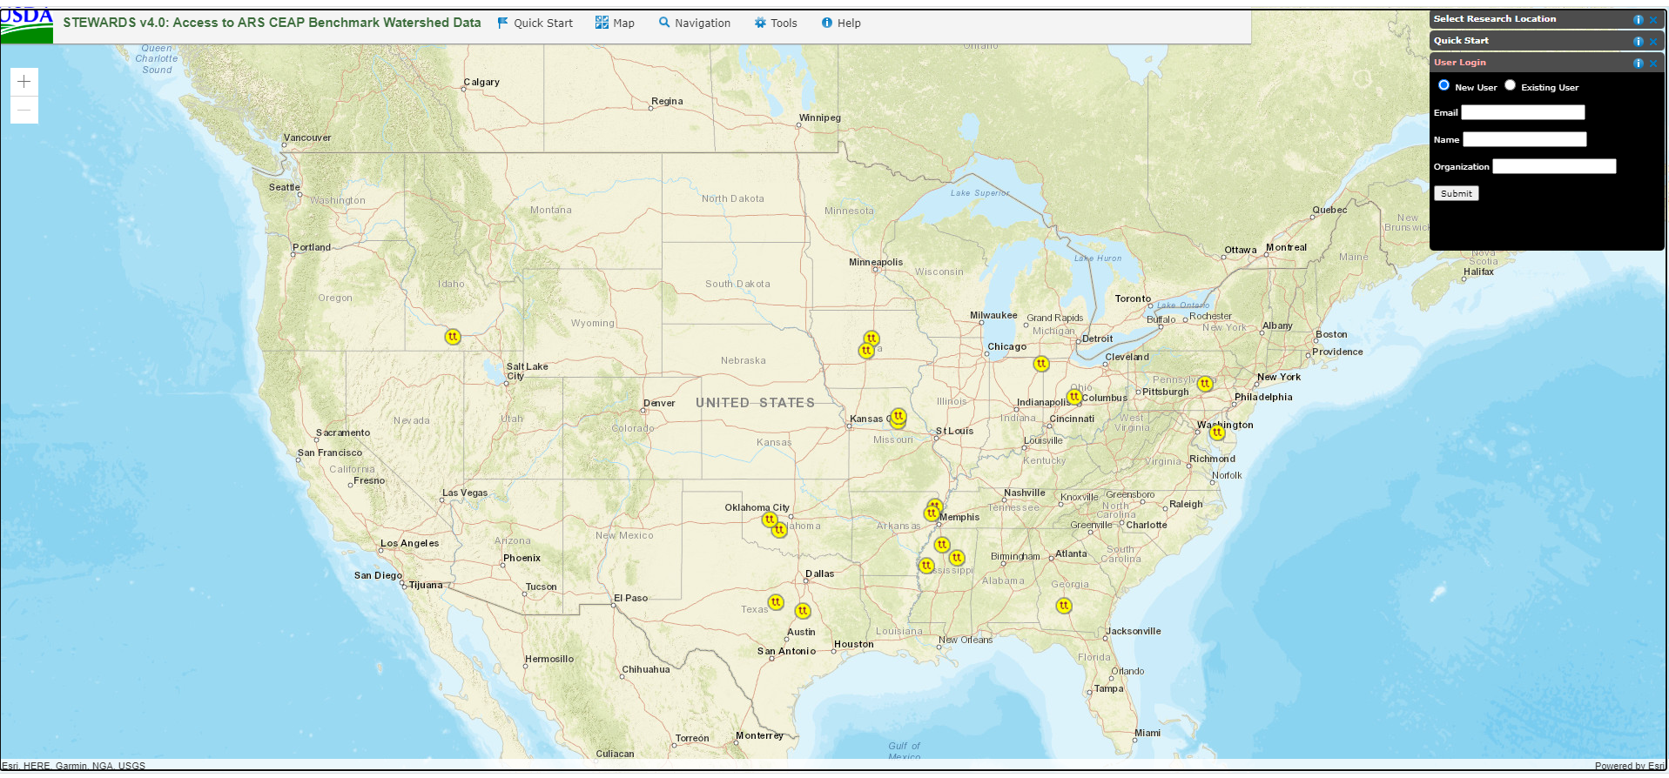
STEWARDS (Sustaining The Earth’s Watersheds – Agricultural Research Database System)
https://www.nrrig.mwa.ars.usda.gov/stewards/stewards.html

Slide 14
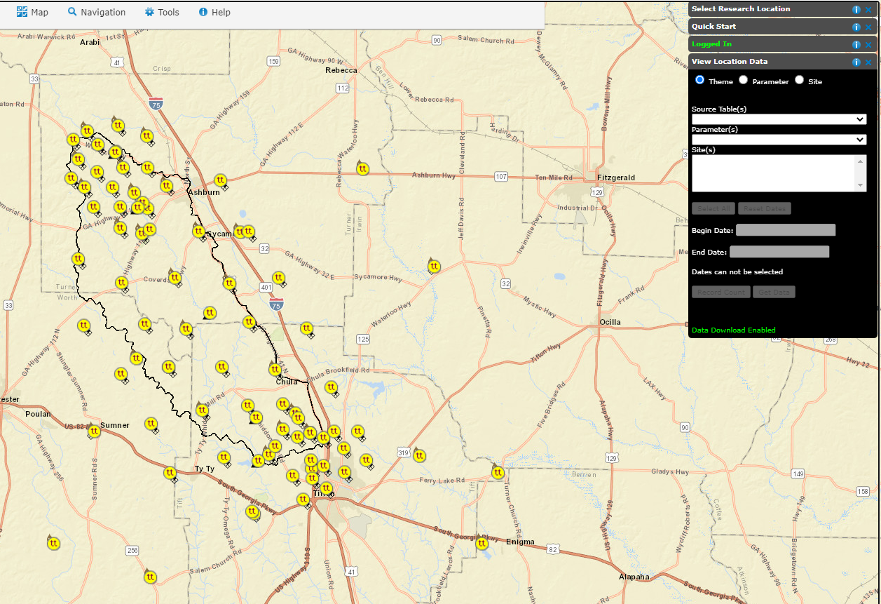
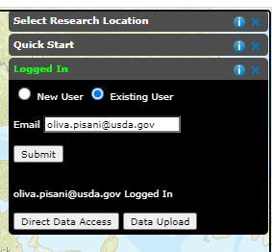
Little River GA
Little River Discharge
Discharge, water, daily, millimeters per unit area
GALR6840

Slide 15
